Slide 1
Hybrid Data Structure
Aravindh | CB.EN.U4CSE21406
K Ganesh | CB.EN.U4CSE21426
Ramnaresh Ulaganathan | CB.EN.U4CSE21447
Shreyas Visweshwaran | CB.EN.U4CSE21455
N S Surya | CB.EN.U4CSE21461
Implementation and Demonstration

Slide 2
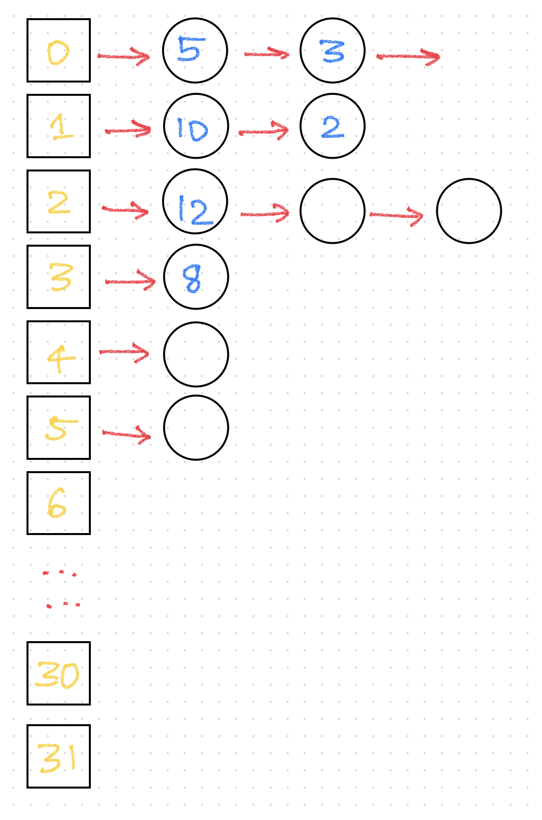
Radix Heap

Slide 3
What is a Radix Heap?
A radix heap is a data structure for realizing the operations of a monotone priority queue.
A set of elements to which a key is assigned can then be managed.
Each element is set to a priority depending on the bit which is the LSB of 1 in the binary representation of a number. Ex: 12₁₀ = 1100₂. Here the least bit where 1 appears is 2. Therefore, a priority of 2 is assumed.
Radix Heap equips a combination of Buckets and Queues data structure.
These are implemented using Arrays and Linked Lists respectively.

Slide 4
Insertion
The insertion operation is designed to not depend on the number of elements in the linked list by making use of the tail pointer which keeps track of the element at the end.
As far as queue structure is concerned, insertion takes place in the end of the list, leaving us with constant time complexity by equipping a tail pointer.
Time Complexity for insertion: O(1) – constant time

Slide 5
Value : 8 10 5 3 12 2
Binary value: 1000 1010 0101 0011 1100 0010
1st comp : 0111 0101 1010 1100 0011 1101
2nd comp : 1000 0110 1011 1011 0100 1110
AND gate : 1000 0010 0001 0001 0100 0010
BIT place : 3rd 1st 0th 0th 2nd 1st

Slide 6


0
5
3
1
10
2
2
12
3
8
Priority Queue :
5
3
10
2
12
8

Slide 7
Minimum Extraction
Minimum extraction is the process of removing the highest priority element with consideration of the element’s priority and the bucket’s queue.
Scanning through the indices of the bucket array, 1st element in the non-empty queue is returned which is the element with highest priority.
Because of this property of highest priority element identification and removal, radix heaps are highly effective for priority based operations.
Time Complexity, worst case: O(max. no. of bits) - linear

Slide 8

Minimum element
By taking an average case scenario, let's say there is no element in the 0th bit place. So, we automatically move to 1st BIT place, and we find the minimum element , which means the element with the highest priority.
0
1
10
2
2
12
3
8

Slide 9
Deletion
Deletion operation takes in the value of an element as parameter,
labels it by index
searches within the linked list and
then deletes the element
also updates the minimum value in the current heap.
The size of the corresponding queue (linked list) is then decremented.
Time Complexity, worst case: O(max. no. of bits + N) - linear

Slide 10
DELETION
Deleting the element containing the value “10”.
0
5
3
1
10
2
2
12
3
8
Priority Queue :
5
3
10
2
12
8

Slide 11
Merging of Two Radix Heaps
Merging operation is used to merge two radix heaps. The corresponding queues in each bucket array of both the heaps are merged using linked list operations involving assignment of head and tail pointers.
The size of both the queues ( which are to be merged ) are considered and appropriate merging operations are implemented.
It is useful in combining multiple priority queues, parallel processing or distributed systems.
Time Complexity, worst case: O(max. no. of bits)

Slide 12
Merging
0
5
3
0
5
3
1
10
2
1
10
2
2
12
2
12
3
8
3
8
Priority Queue :
5
3
10
2
12
8
Priority Queue :
5
3
10
2
12
8

Slide 13

Traffic Light System
Using Radix Heap

Slide 14
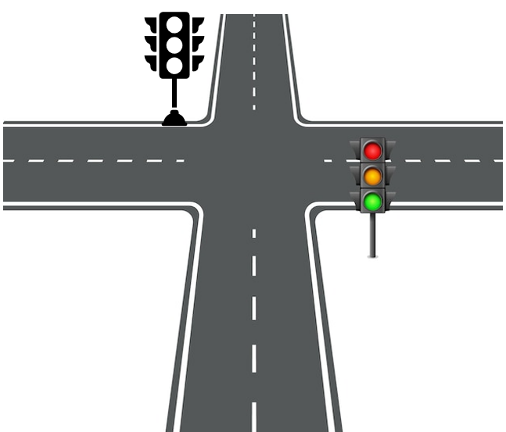
RED LIGHT
YELLOW LIGHT
GREEN LIGHT
0
25
0
15
25
0
33
15
1
10
1
22
30
1
30
22
2
20
2
20
2
12
3
120
MINIMUM VALUE :
25
15
33

Slide 15
COMPARISION
Array
Fixed size
Difficult to insert or delete elements
LinkedList
Dynamic size
Easy to insert or delete elements
Radix Heap
Fixed size
Easy to insert or delete elements
Space Complexity is O(n) and Time Complexity for insertion is O(n).
Space Complexity is O(n) and Time Complexity for insertion is O(1).
Space Complexity is O(n) and Time Complexity for insertion is O(1).

Slide 16
Benefits
Faster insertions and deletions.
Better cache locality.
More efficient for large values.
Small memory footprint.
Easy to implement.

